Slide 1
Beijing Housing Prices
Junseok Yang Himanshu Kumar Matthew Jewell
Predicting Total Price and Identifying Over- and Underpriced Listings

Slide 2
Data Overview
318,851 overservations
26 variables
Challenges: Missingness and translation
“DOM” had nearly 50% of observations missing
Translation and processing issues with “Floor” variable
Limitations: Mostly computational

Slide 3
Project Objectives
Regression: Create a regression model which can accurately predict a real estate listing’s total price, given other information about the listing.
Clustering: Create clusters which effectively group listings with similar attributes to identify over- and underpriced listings.

Slide 4
Setting a Benchmark: Other Groups’ RMSEs
RMSE by Group Predicting Total Price
A | B | C | D | E
124.3104 | 144.755 | 136.775 | 89.822 | 126.304
Many groups used metrics other than RMSE to measure model performance, including RMSLE and score functions from packages in Python.
Our group opted for RMSE because it is easily recognized and understood.

Slide 5
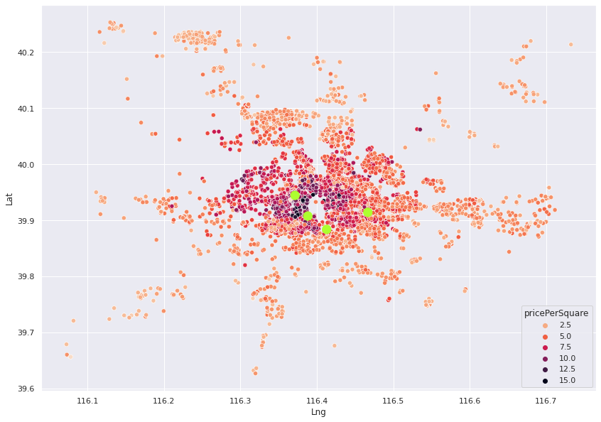
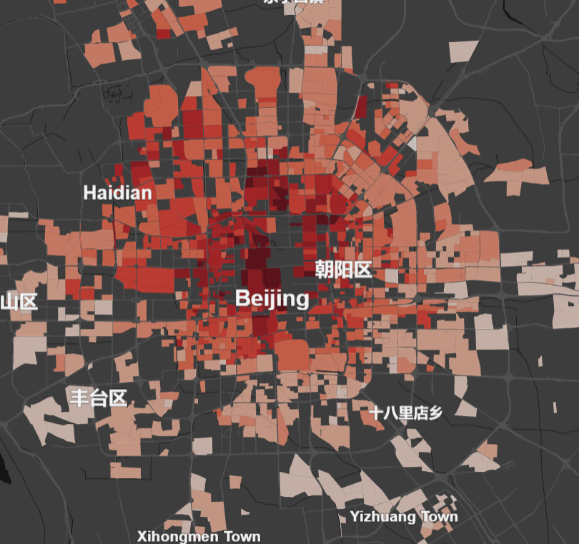
Literature Review Findings
Latitude and longitude data fit into Beijing city-blocks using spatial joining. The colors indicate average property price per square meter.
Map of Beijing with Tiananmen Square, Temple of Heaven, Xin Jiekou, and Beijing International Trade Center (green dots).

Slide 6

Identifying the Epicenter
Examining the images on the previous slide, we noted what appeared to be an epicenter from which the high listing prices radiated.
Using Google Maps, we were able to identify a landmark in that region: Jingshan Park.
We found the latitude and longitude for Jingshan Park and used that information to create a “Distance” variable which replaced our longitude and latitude variables with one measurement of how far a listing was from Jingshan Park while accounting for the Earth’s curvature.¹
¹ This was accomplished with a function and the “geosphere” package.

Slide 7
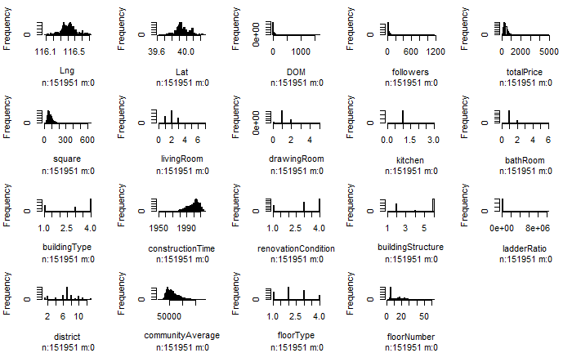
HISTOGRAM OF VARIABLES

Slide 8
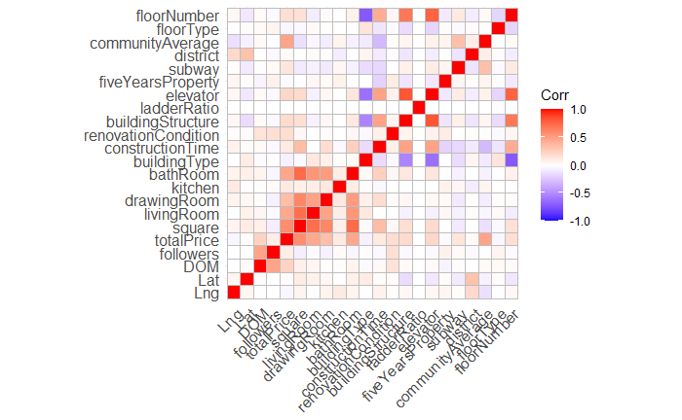
VARIABLES CORRELATION HEATMAP

Slide 9
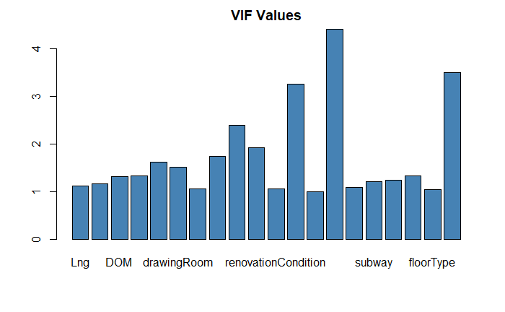
VIF VALUES
VIF value of floor type = 1.042120

Slide 10
LINEAR REGRESSION
A model was selected using the step function and based on the least AIC value (1074655). According to this, Ladder ratio and Longitude were not statistically significant.
Based on lowest Mallows’ Cp using the regsubsets function, the best model was the one that excluded Longitude and Ladder Ratio. (Mallows’ Cp: 20.07409)
Ridge and Lasso regression models were selected using the cv.glmnet function with nfolds = 10.
The minimum lambda values for ridge and lasso are 0.0083 and 0.0085 respectively.

Slide 11
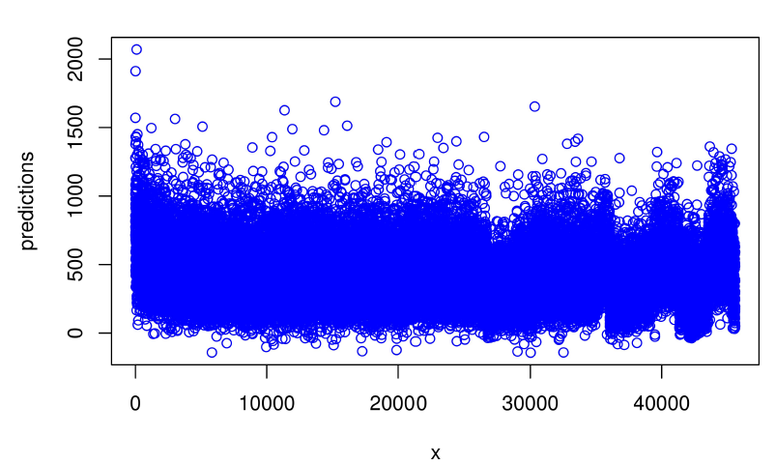
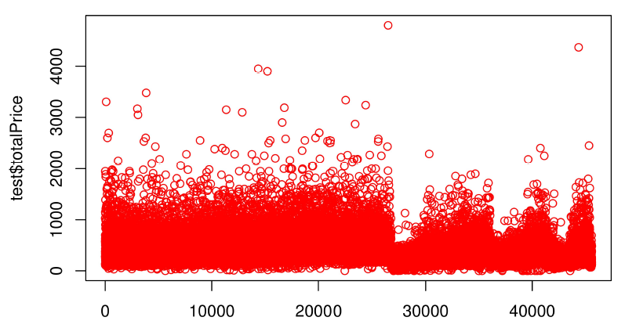
PREDICTED VS. ACTUAL VALUES (LINEAR REGRESSION)

Slide 12
K-Nearest Neighbors
KNN regression was done using knnreg function.
The tuning parameter was the k value.
The ideal k value, based on the least RMSE value, was found to be k = 8.
The RMSE for KNN regression is less than linear regression and the R-squared value is also greater for the KNN model.

Slide 13
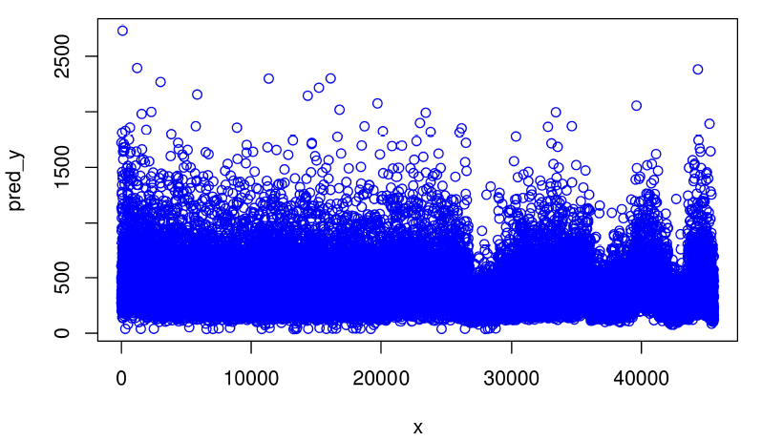
PREDICTED VS. ACTUAL VALUES (KNN)

Slide 14
Extreme Gradient Boosting
Used Caret package to train the model using xgb.train.
The tuning parameters include “max.depth”, “nrounds”, and “lambda”.
The ideal values for these parameters were found to be 7; 400 and 3.
The least values for test-RMSE as well as the train-RMSE were found to be at the 257th round.

Slide 15
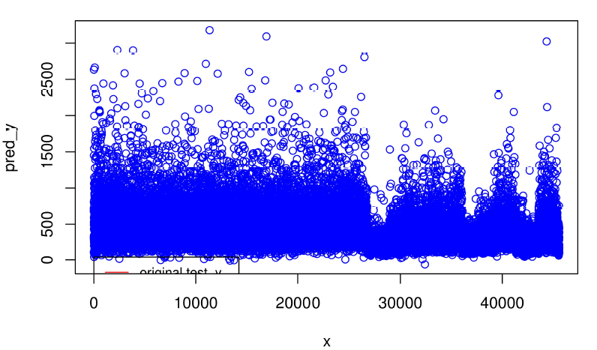
PREDICTED VS. ACTUAL VALUES (XGBOOST)

Slide 16
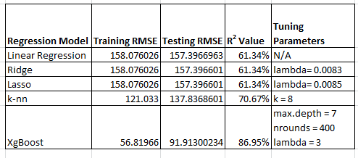
COMPARING THE DIFFERENT REGRESSION MODELS

Slide 17
Unsupervised Learning
Cluster Analysis

Slide 18
Purpose / Research Goal
Group / Identify the data
Similar / dissimilar
Notable features that share within or distinguish between the groups
Meaningful trends behind the real estate market
Some common beliefs…
Association between ’price’ and top 10 predictors

Slide 19
Method / Data Pre-processing / Limitation
Method
K-Means Clustering
Data Pre-processing
Random sample size of 1000
Scaling & Conversion
Mean 0 & Standard Deviation 1
Gower’s distance
Convert mixed data (Numeric + Non-numeric) to numeric
Limitation
Representativeness
Lack diversity
⋮

Slide 20
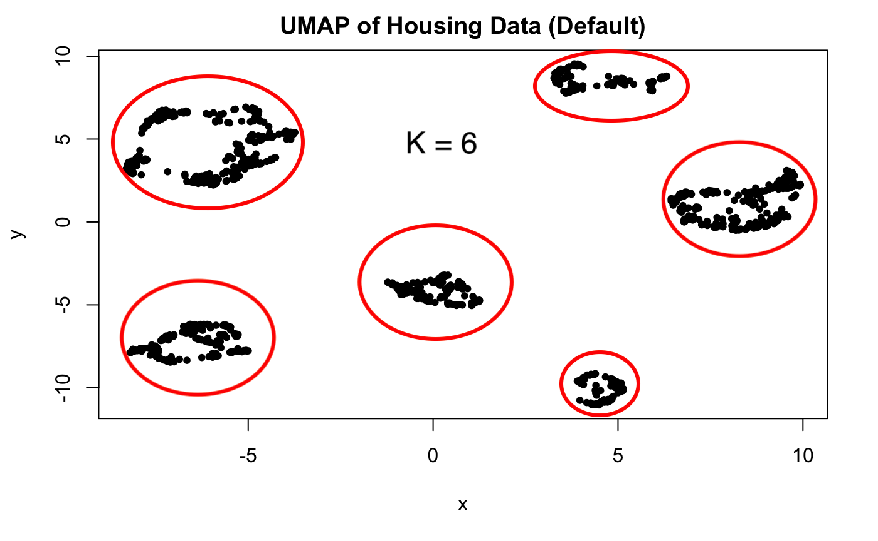
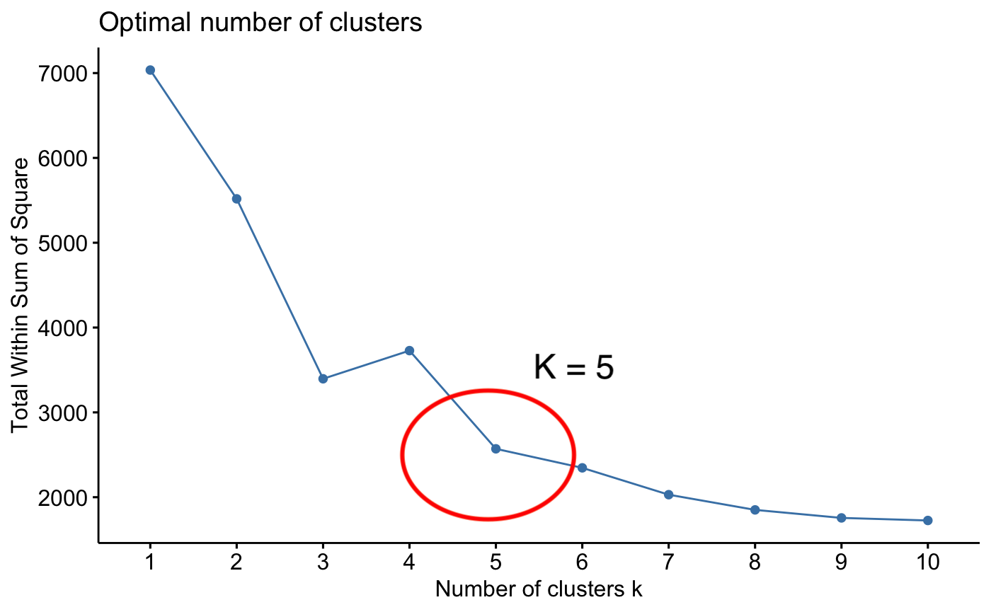
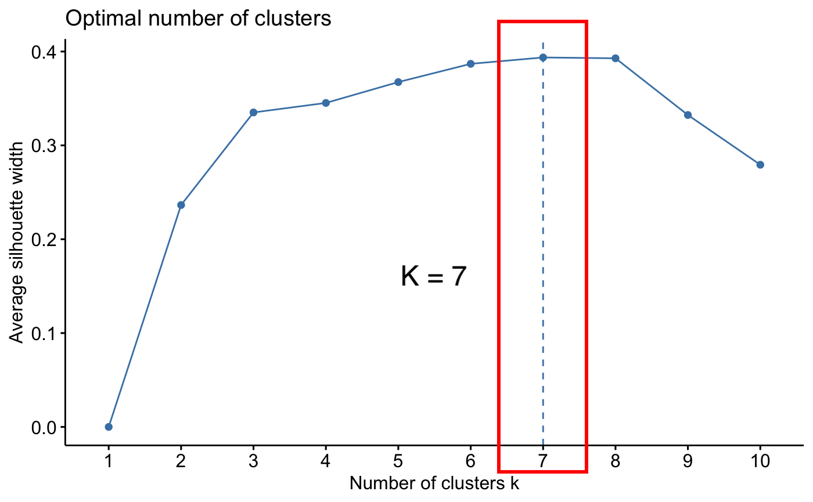
Optimal Number of Clusters
UMAP (Uniform Manifold Approximation and Projection)
Dimensionality Reduction
Data formation
Elbow method
Minimize within cluster variation
Silhouette score
Cohesiveness within a cluster & Separation between clusters
K = 6

Slide 21
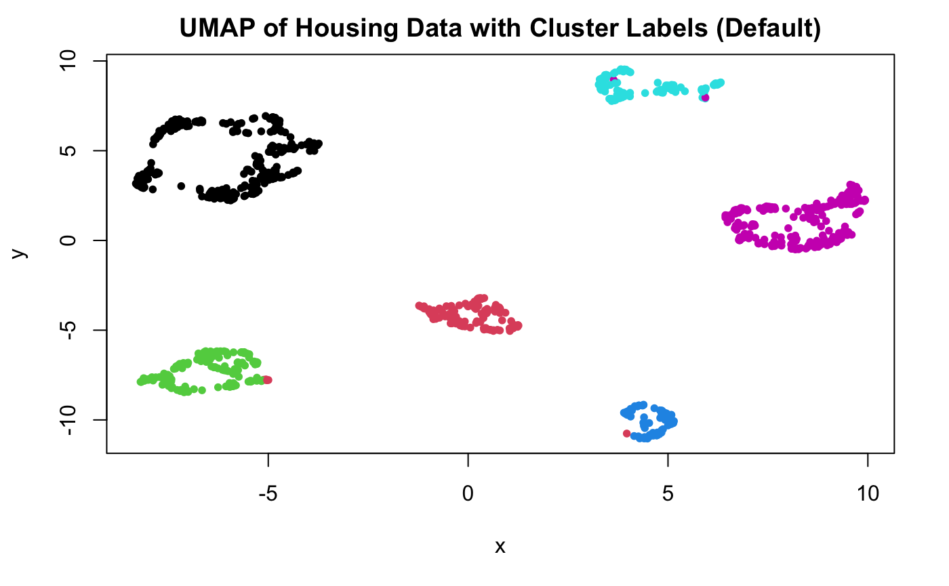
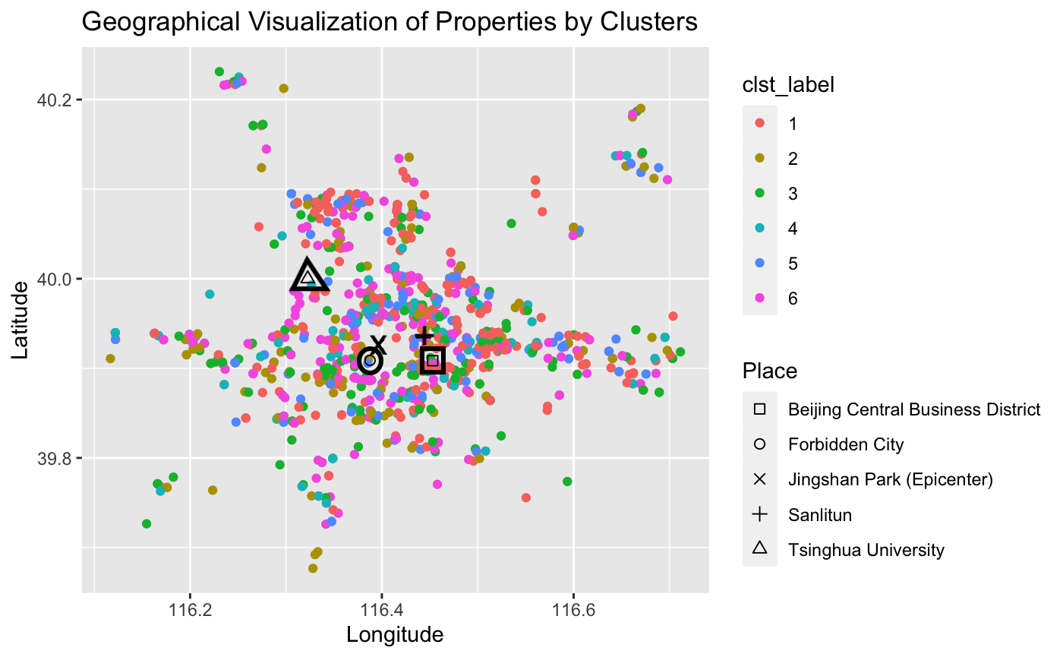
Cluster Analysis
Match with the groups
Not meaningful trend based on geographics

Slide 22
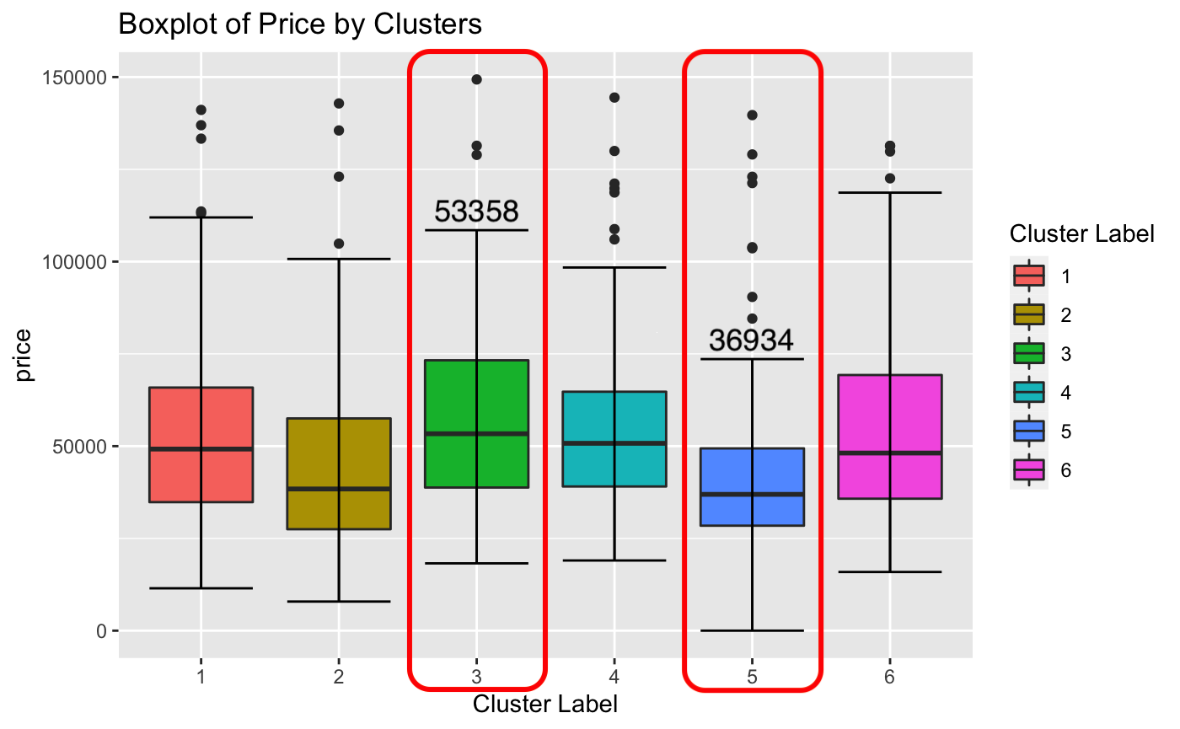
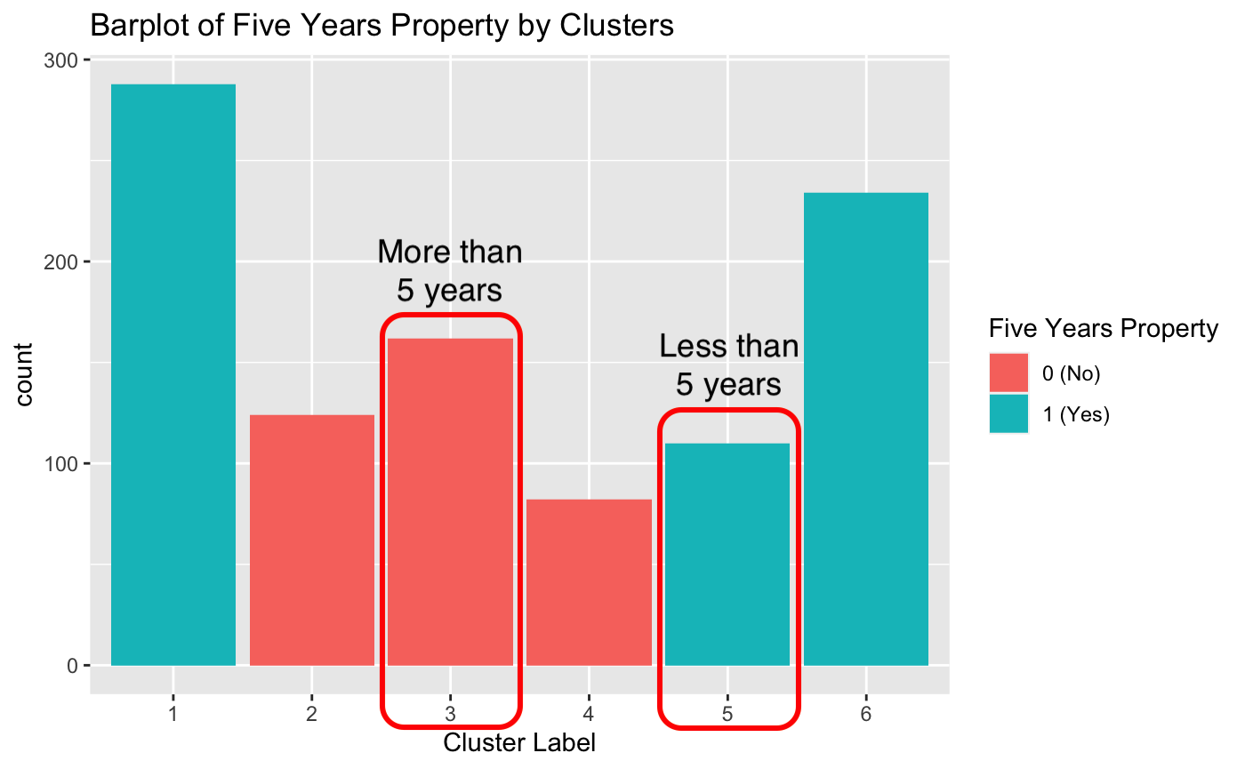
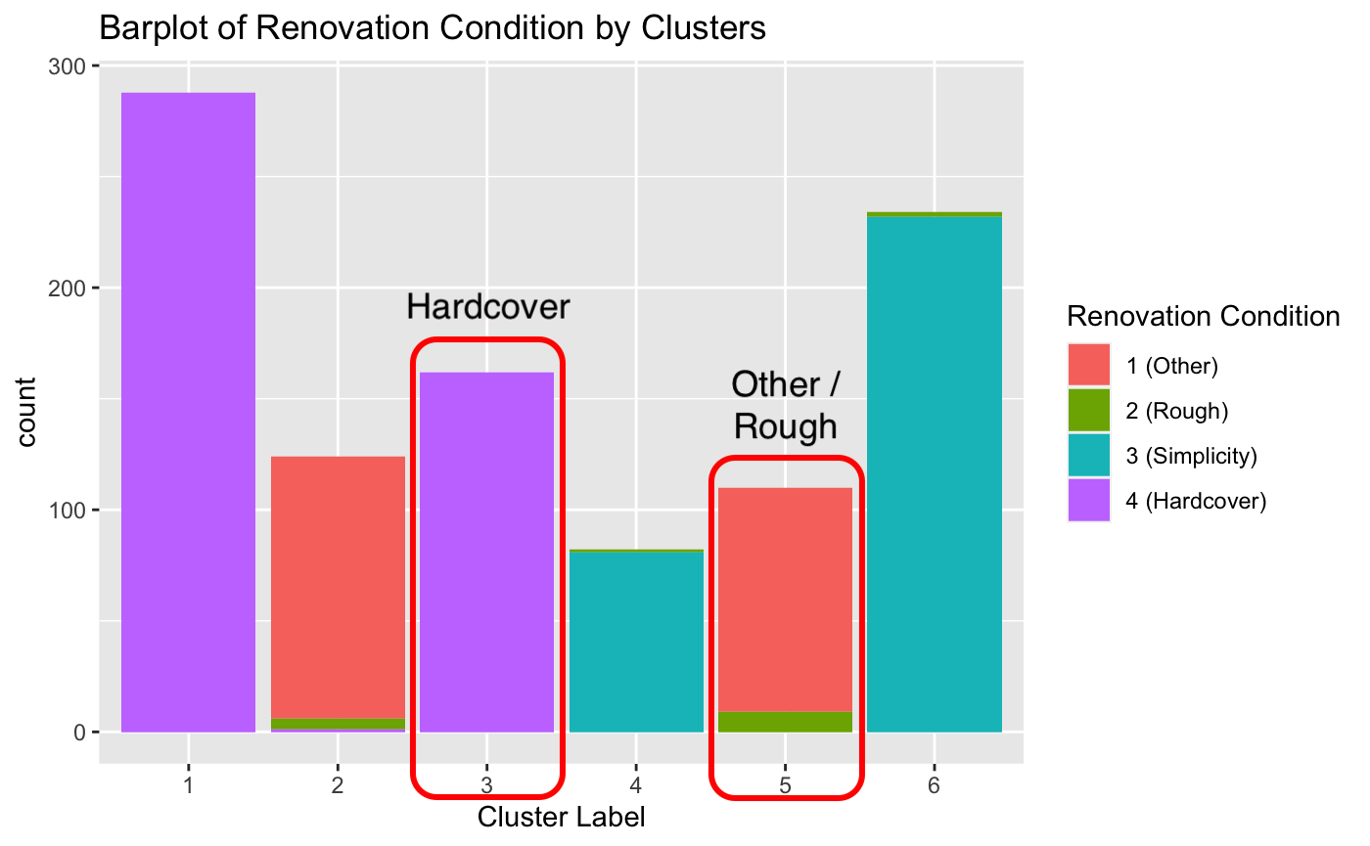
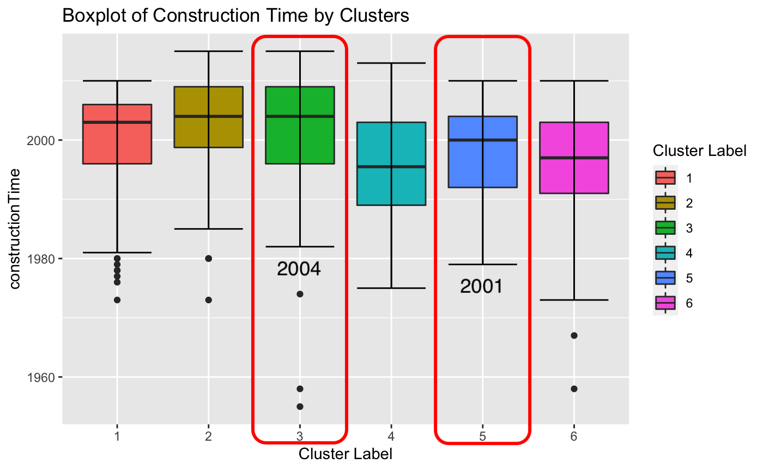
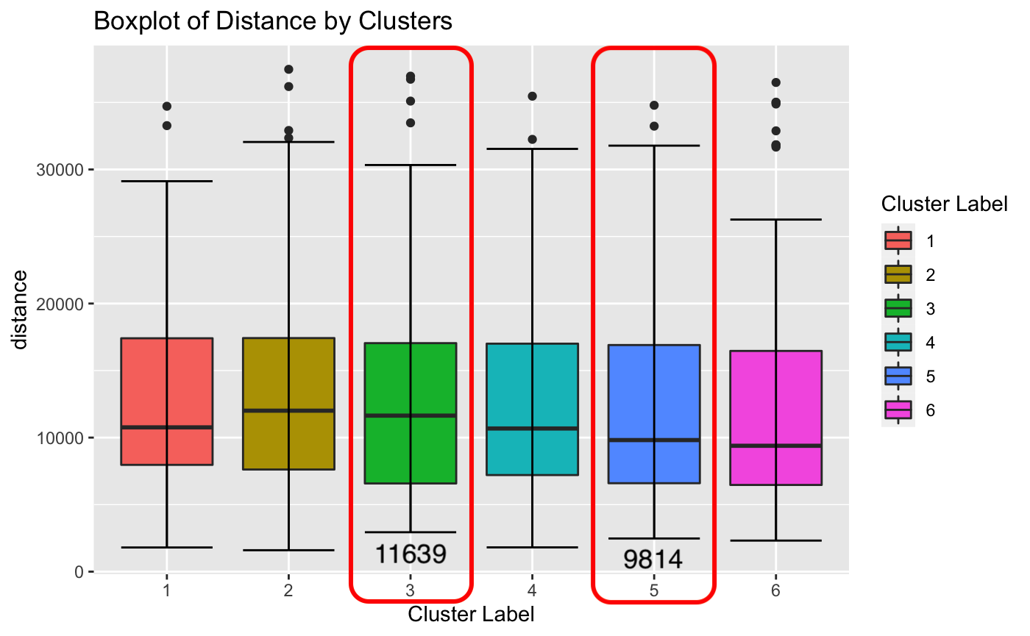
Cluster Analysis
Expensive vs Cheap
Modern vs Old
Hardcover vs Other
More than 5 years vs Less
High-rise vs Low-medium
Farther from the epicenter…

Slide 23
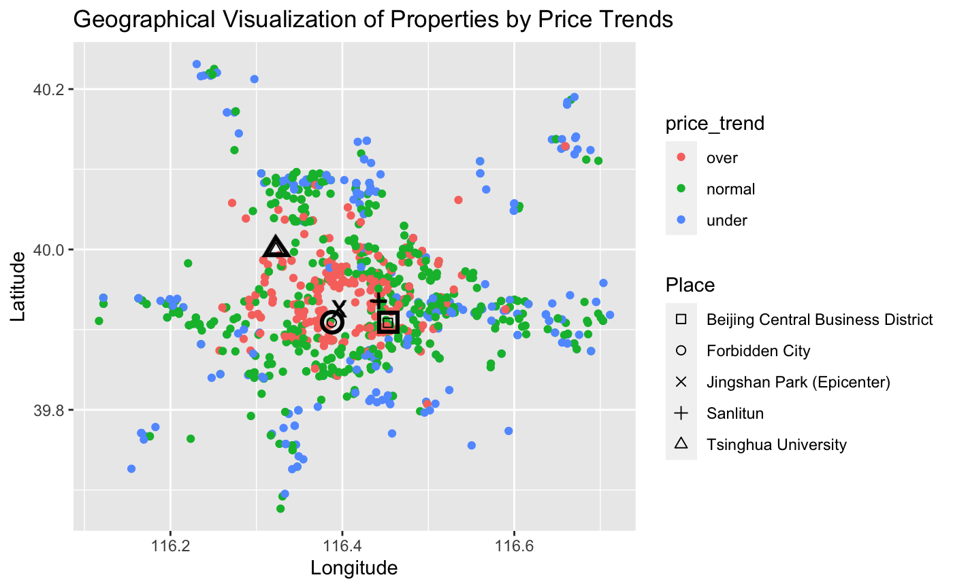
Price Trends
Trends within a cluster
Price less than 25th percentile (Q1) → Under
Price greater than 75th percentile (Q3) → Over
Price in between the 25th and 75th percentile → Normal
Notable ‘Price Trend’ based on geographic

Slide 24
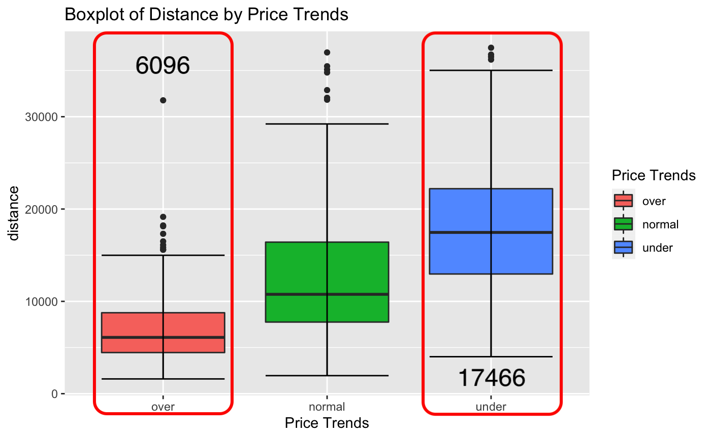
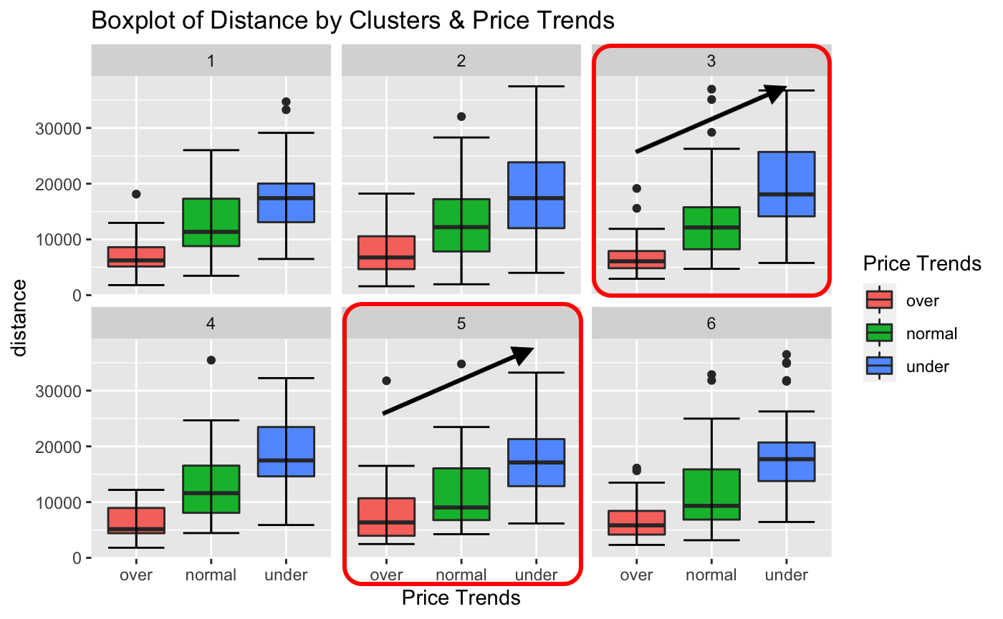
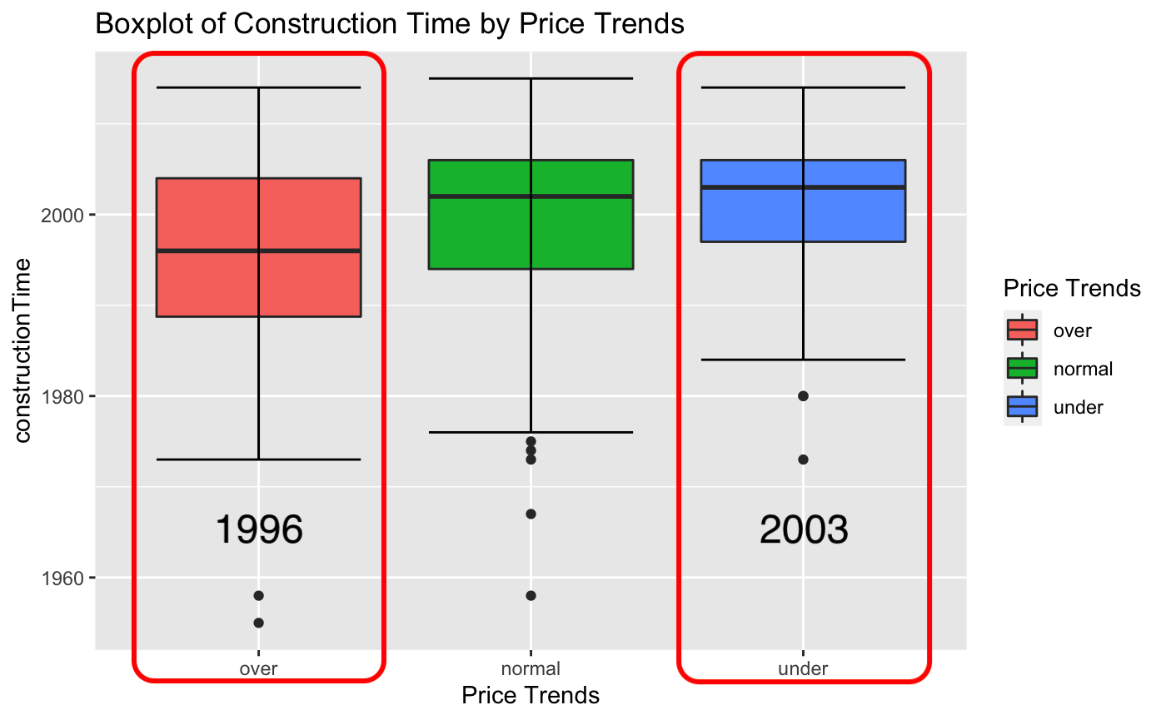
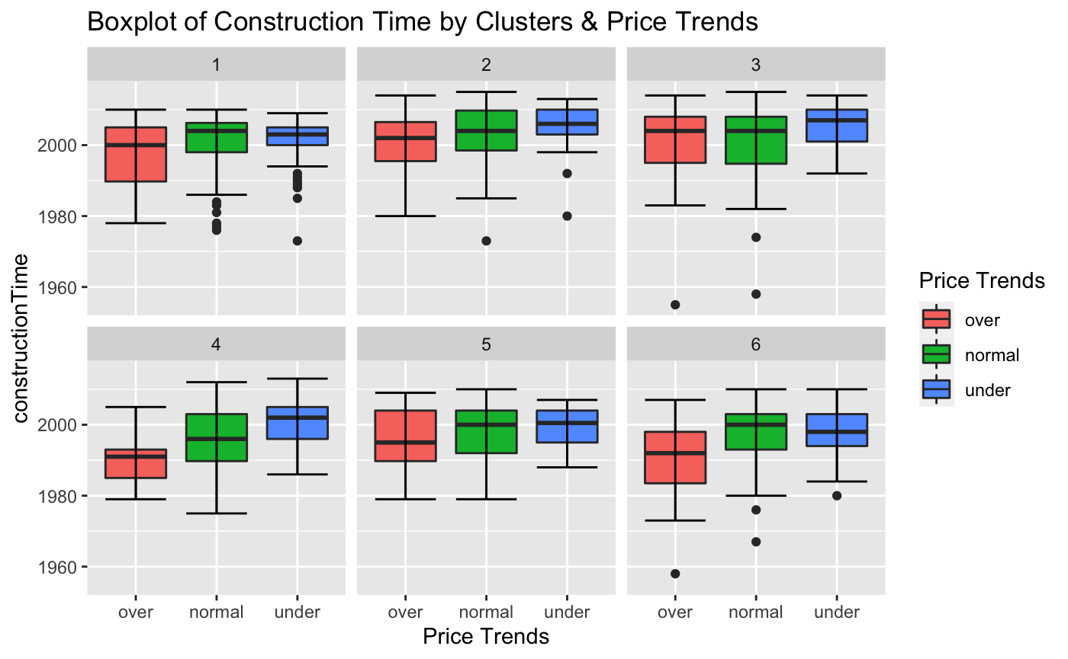
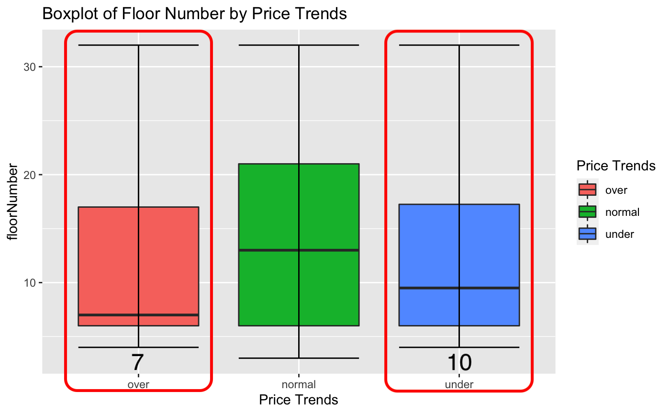
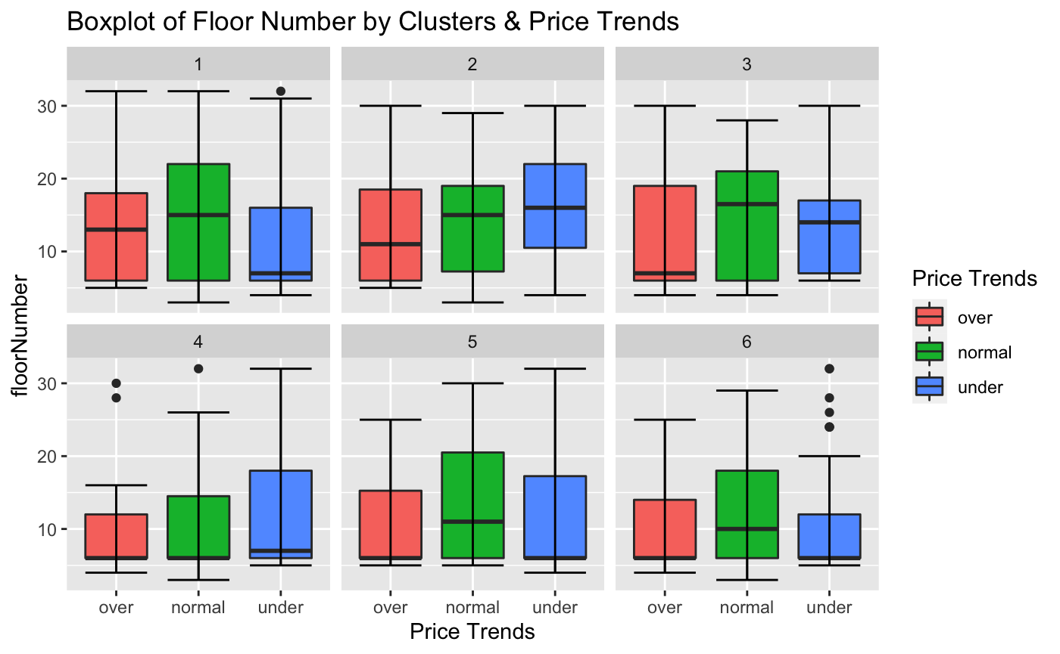
Price Trends vs X
Distance aligning with Price Trends
Closer → Over
Opposite trends
Over tends to be…
Old
Low-Medium stories
City Planning Viewpoint
Center → Outside (Suburb)
Old & Low → Modern & High
More infrastructures around the epicenter

Slide 25
Takeaways
Clusters
Possible Key factors
Construction Time / Renovation Conditions / Five Years Property / Floor #
Expensive vs Cheap
Modern vs Old / Hardcover vs Other (Rough) / More than 5 years vs Less / High vs Low
Price Trends
Distance
Opposite factors : Construction Time / Floor #
City Planning Perspective
Caveats
Data from 2011 to 2017
May not reflect current real estate market (e.g. Policy & Regulation)

